Slide 1
Convolutional Neural Networks for Predicting Daily Orographic Precipitation Gradients for Precipitation Downscaling
CIROH Developers Conference
Hydrological Applications of Machine Learning Workshops
Savanna Wolvin
05.30.24

Slide 2
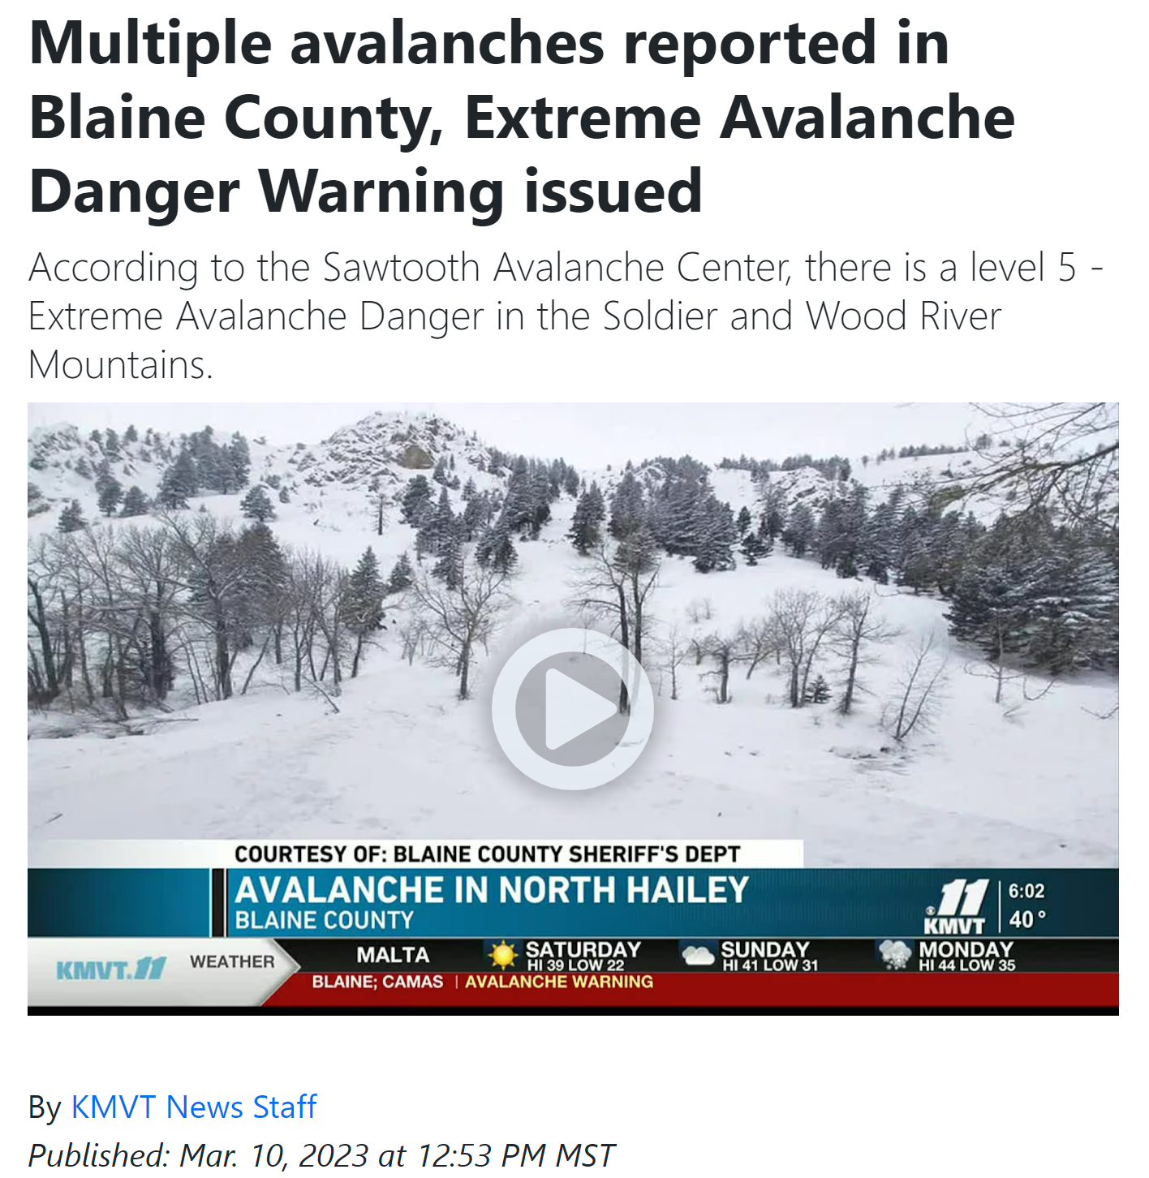
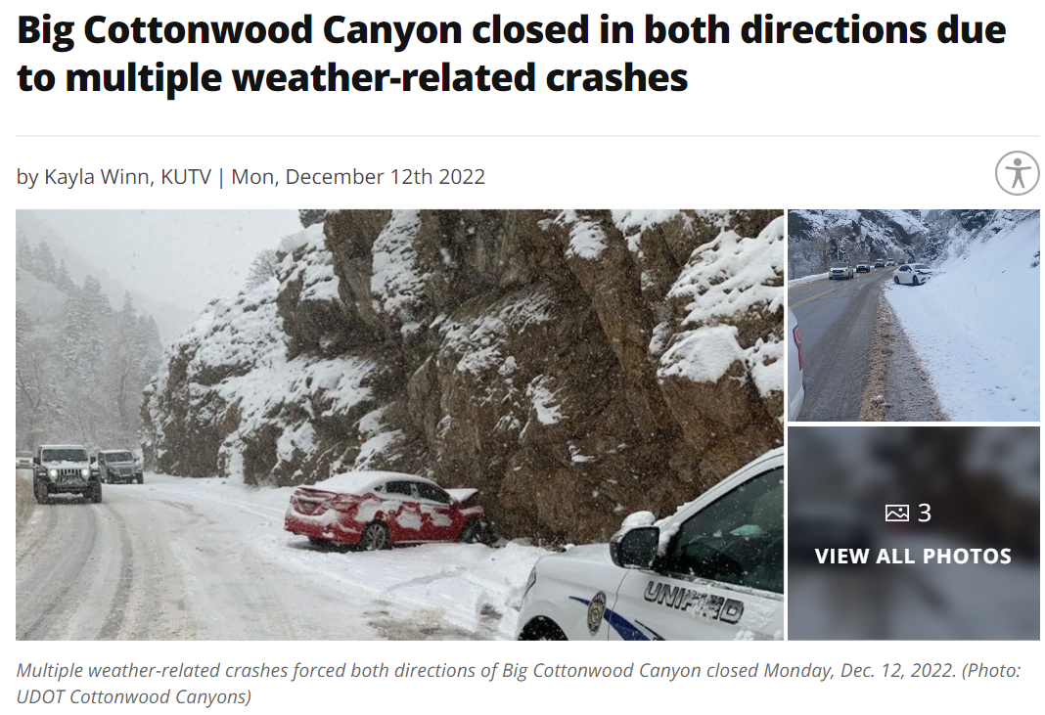
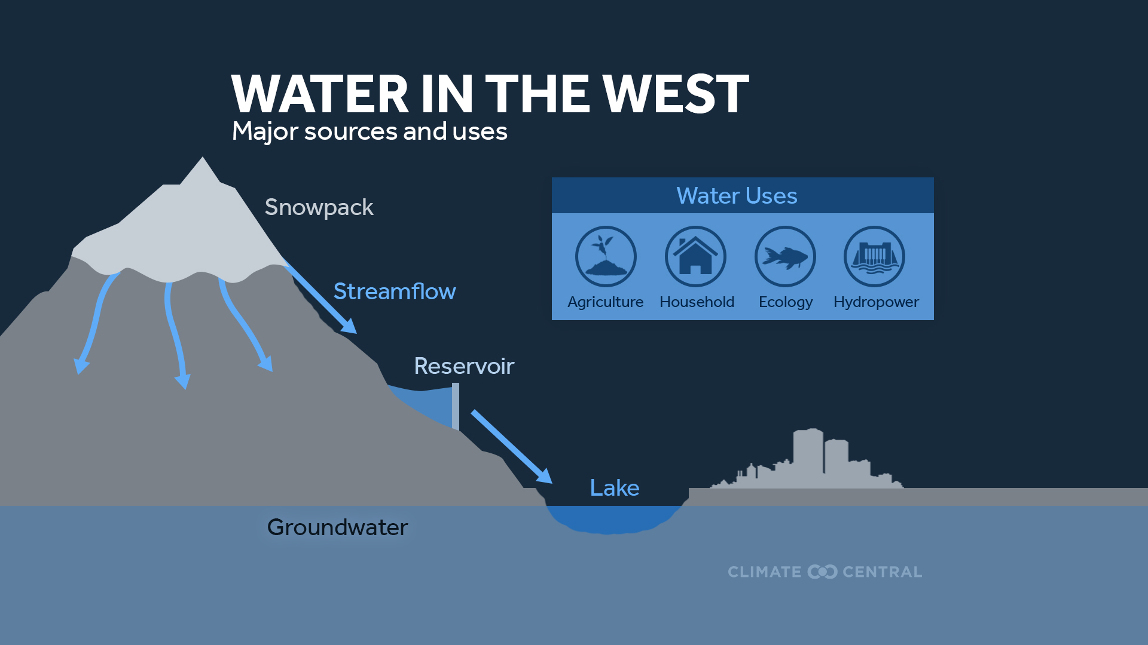
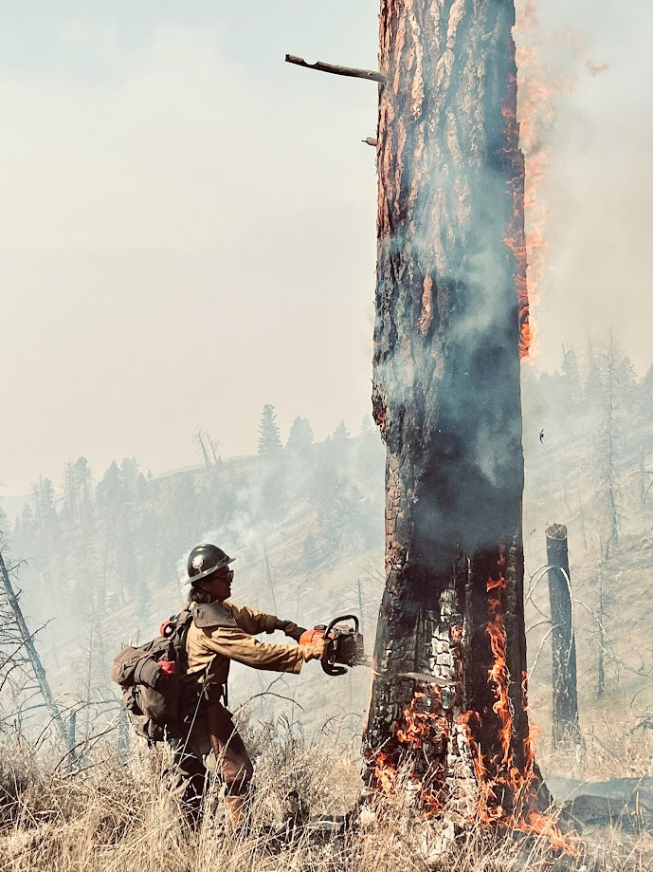
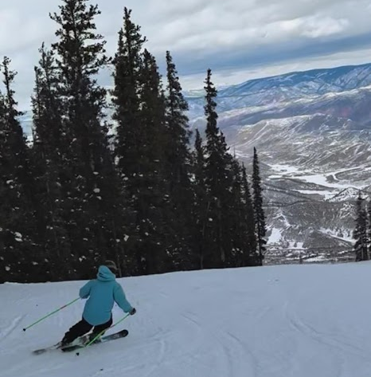
Importance of Western CONUS Snowpack
Seasonal snowpack acts as a natural water tower – storing wintertime precipitation
71% of total runoff in the mountainous west is from snowmelt
Courtesy of John Walter
Fig. Water in the West (Courtesy of climatecentral.org)
Courtesy of Grace Cawley
Notes:
Snowpack distribution and amount affects public safety, like avalanche risk and the ability to travel, outdoor recreation and the tourism revenue gained by western states, and the summertime wildfire risk
Recreation – (Burakowski and Magnusson 2012) brings about 6 billion dollars to the western US
Public Safety – (Black and Mote 2015)
Wildfire - (Westerling 2016)
The western US is snowmelt-dominated for its streamflow (Barnett et al. 2005)
The Red line indicates snowmelt-dominate without adequate reservoir storage capacity to buffer shifts in seasonal melting (Barnett et al. 2005)
Percentage of annual precipitation as snowfall: Sierra Nevada (67%), NW Wyoming (64%), Colorado (63%), Idaho/W Montana (62%), PNW (50%), AZ/NM (39%) (Serreze et al. 1999)
“Across the western US, 53% of the total runoff is derived from snow” (Li et al. 2017)
71% of the annual average runoff in the mountainous west is snowmelt (Li et al. 2017)
“Snowmelt produces 71% of the total runoff in mountainous areas in the west” (Li et al. 2017)

Slide 3
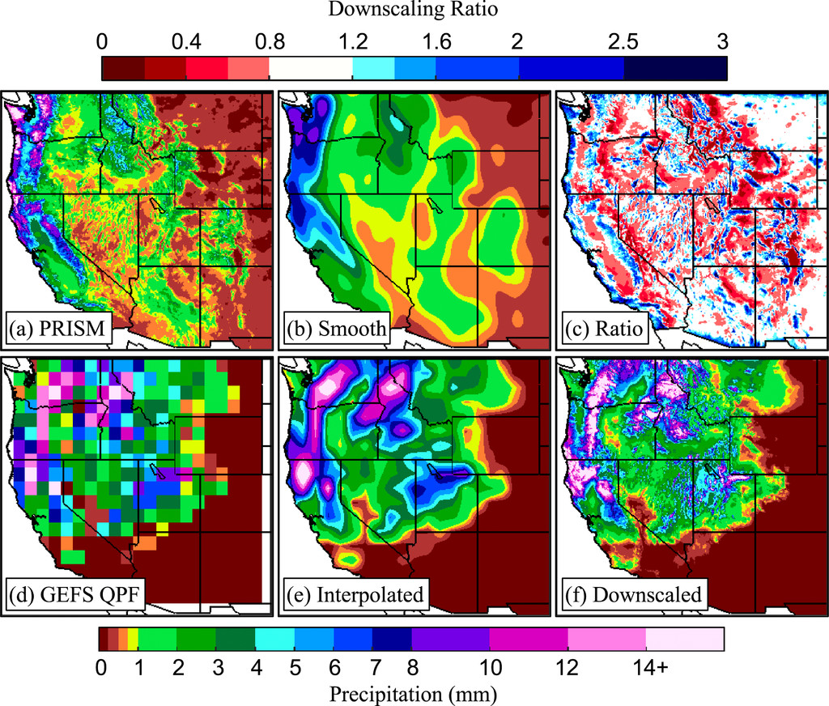
Current Orographic Downscaling Method
Precipitation-elevation Regressions on Independent Slopes Model (PRISM)
Downscales using the climatological distribution of precipitation with elevation
Downscales the GEFS from ~33 km to ~800 m horizontal resolution
Does not account for event-to-event variability of precipitation
Fig. 24 Jan 2016 PRISM climatological precipitation (a), smoothed precipitation (b), downscaling ratio (c), 24 Jan 2016 GEFS forecast (d), interpolated GEFS forecast (e), downscaled precipitation (f).

Slide 4
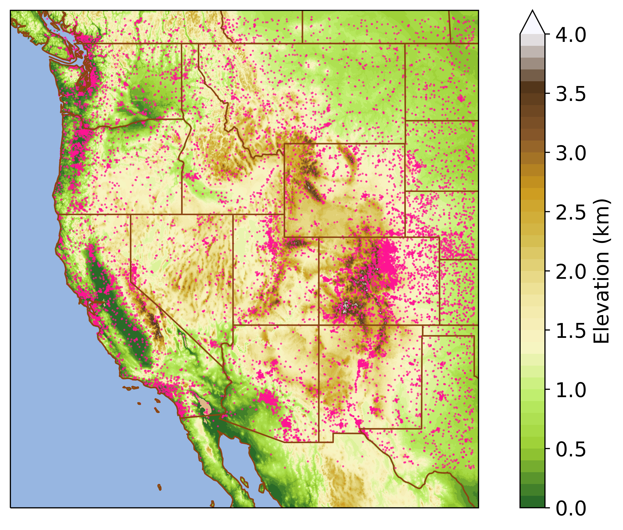
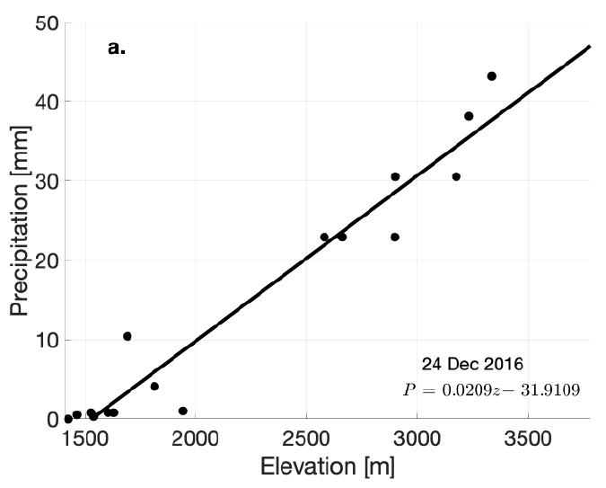
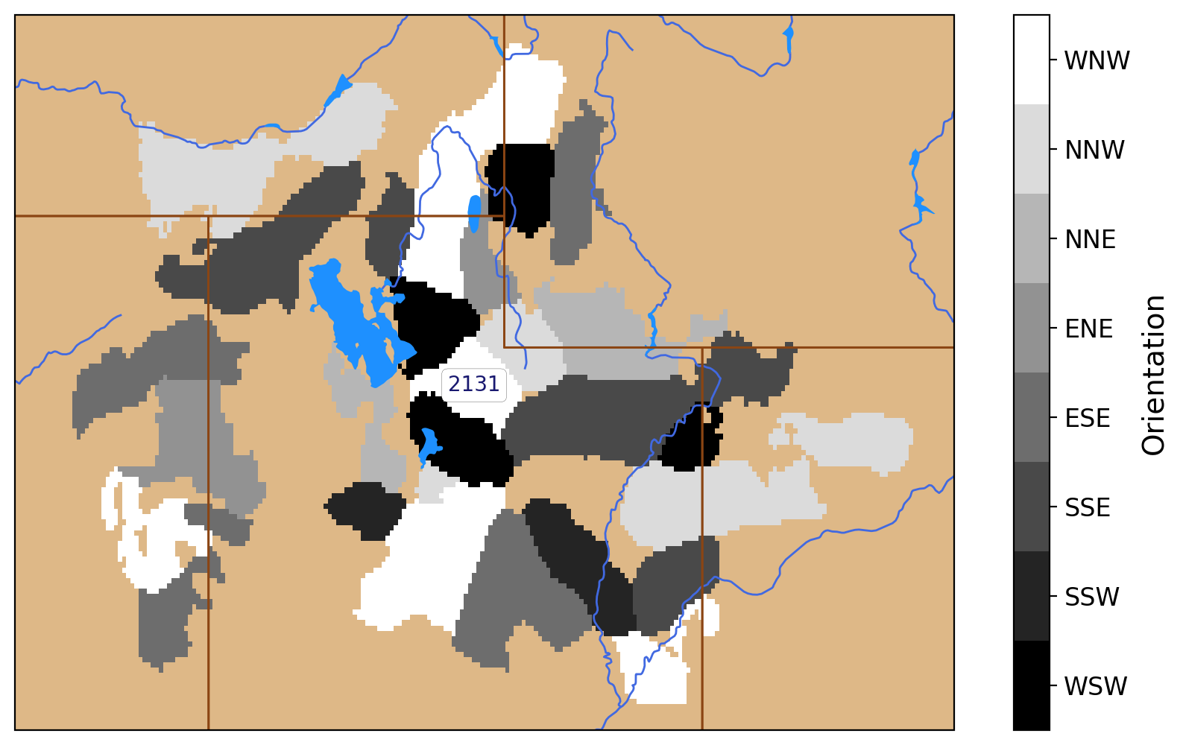
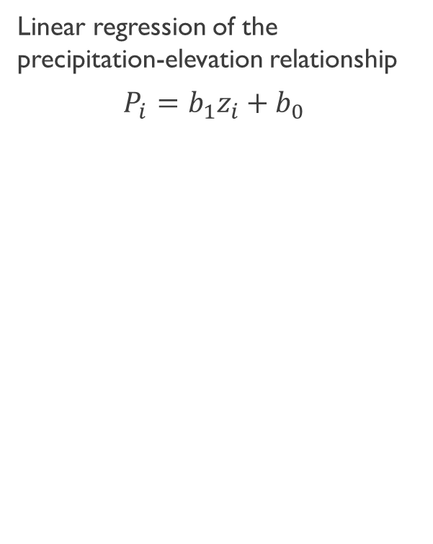
Precipitation and Terrain
Faceting Algorithm
Orographic Precipitation Gradients (OPG)
Global Historical Climatology Network-Daily
1979-2018
Global 30 Arc-Second Elevation (GTOPO30)
Drawn to approximately 4-km resolution
Terrain orientations are binned into 8 secondary intercardinal coordinates
Regions deemed flat are removed
Regions with the same orientation are called facets
Linear regression of the precipitation-elevation relationship
$$P_{i}=b_{1}z_{i}+b_{0}$$
Fig. Precipitation-elevation regression
Fig. GHCN-Daily mesonet locations (pink) and 4-km resolution terrain (shaded)
Fig. Northern Utah Facets

Slide 5
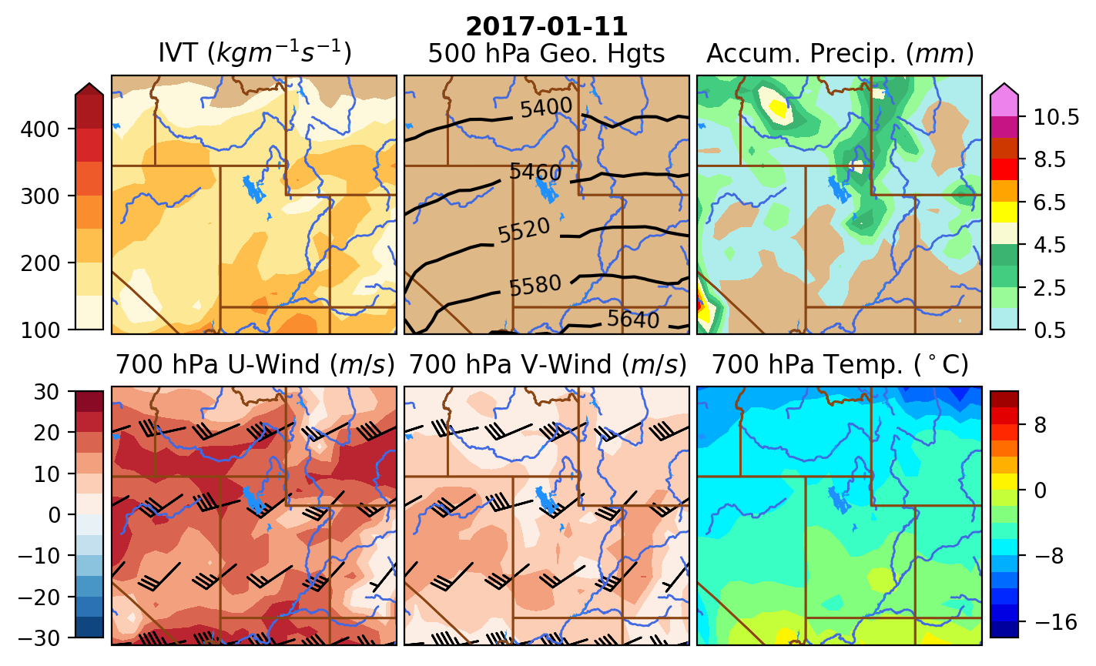
Predictor Dataset
ECMWF ERA5 at 0.5° Grid-Spacing
Variables | Levels (“Images”)
Integrated Vapor Transport | Formulated from Specific Humidity, U-Winds, and V-Winds
U-Winds | 700 hPa
V-Winds | 700 hPa
Geopotential Height | 500 hPa
Accumulated Precipitation | Surface
Temperature | 700 hPa
Fig. CNN input domain and variables
Notes:
Why this size of domain?
Looking more for the widespread variability of OPG which is dependent on the synoptic setup, the CNN itself should pick up on the differences between facets
Small scale forecast models are not as good, ie, resolutions of terrain, and larger differences between models

Slide 6
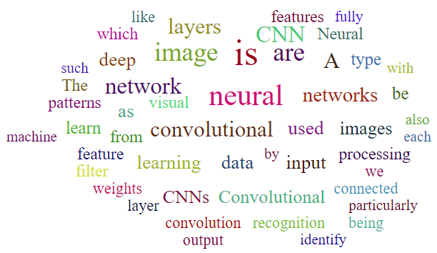
What is a Convolutional Neural Network
Notes:
I usually like to start talks like this with a definition, but the definitions I found online were so long winded and I felt never got to the true point. So I made a word cloud based on a handful of those definitions. Obviously we see the words convolution, convolutional, neural, and network.
The words picked out that hits the point of a convolutional neural network are image, images, patterns, features, learning, recognition, and such.

Slide 7
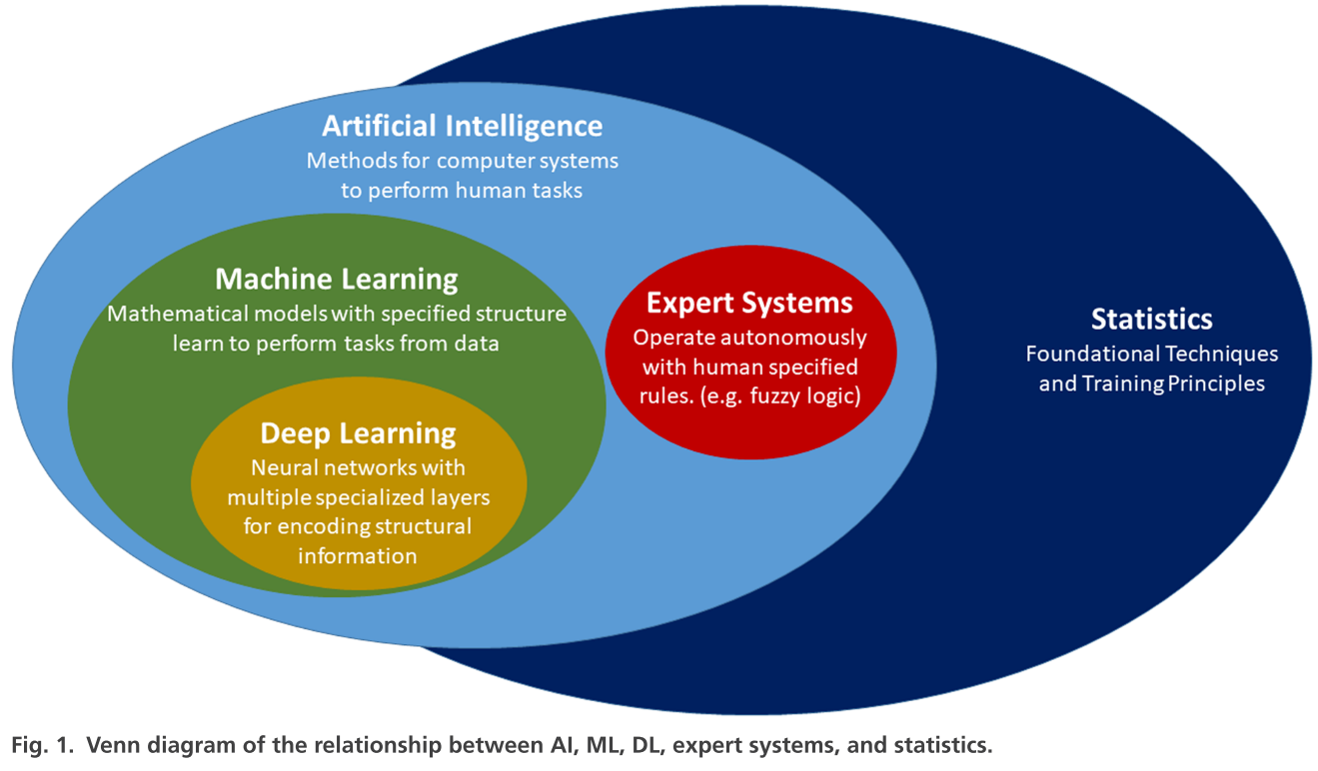
Convolutional Neural Networks

Slide 8
Really, what is it?
Convolutional Neural Networks are…
A supervised learning algorithm → Trains on labeled datasets to classify or predict
A deep learning neural network → A neural network with more than a few layers with the functionality to learn its own parameters/weights
For computer vision → Artificial intelligence algorithm which allows a computer to interpret images or visual data
Notes:
The category of convolutional neural networks do the best job to describe what it is, in my opinion. It’s a supervised learning algorithm, meaning it uses labeled datasets to train itself for classification or prediction problems. It is a deep learning neural network, meaning it has more than a few layers in the algorithm and learns its own parameters based on the training dataset. And they are for computer vision, aka its an algorithm created to allow a computer to interpret images or visual data since computers cant really ‘see’ things.

Slide 9
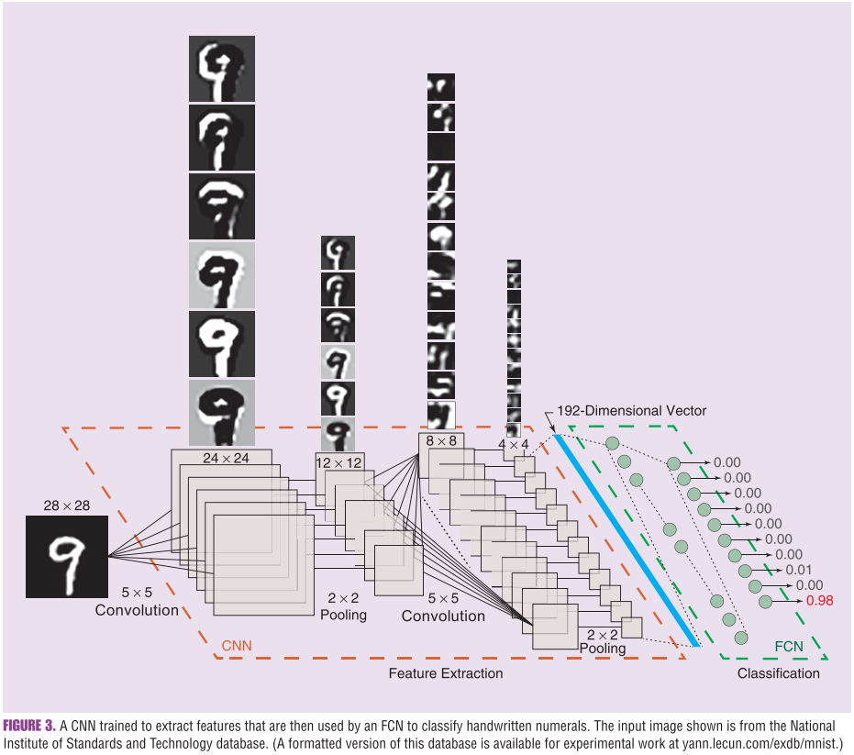
Handwriting Classification Example
Convolutional Layer
Pooling Layer
Convolutional Layer
Pooling Layer
Flattening
Fully Connected Neural Network of Dense Layers
Input Image
Output for Classification

Slide 10


Extracting Image Features
Convolutional Layer
Pooling Layers
Alters an image with a small learned filter (also known as a kernel), that highlights different patterns, edges, or values
Reduces the resolution of an image by taking the mean or maximum values from a passing window
Reduces processing power needed and forces the convolutional layers to evaluate consecutively larger areas
https://paperswithcode.com/method/max-pooling
https://en.m.wikipedia.org/wiki/File:2D_Convolution_Animation.gif

Slide 11
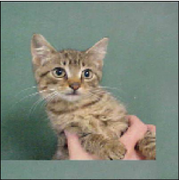
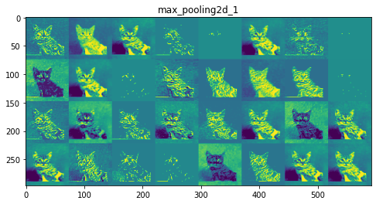
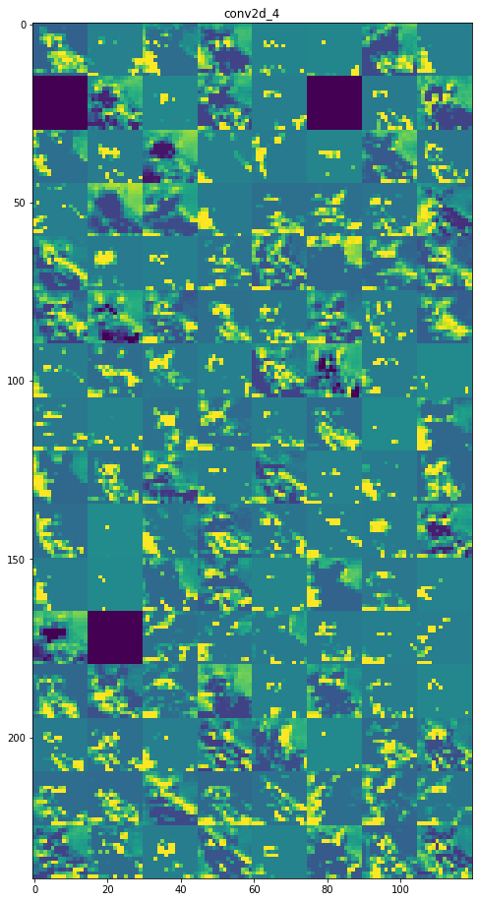
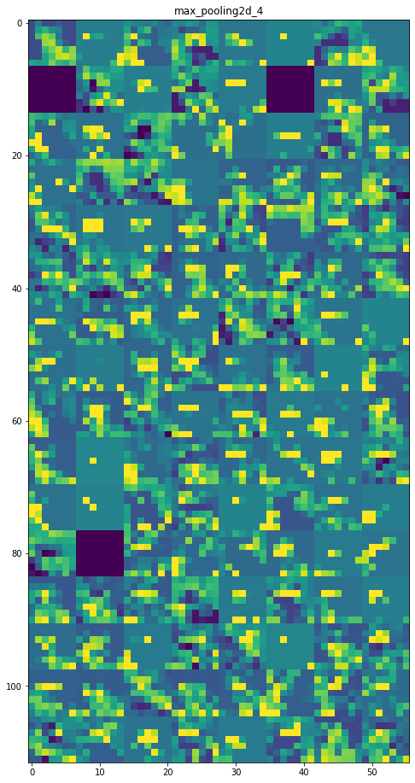
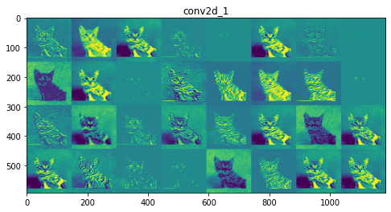
Extracting Image Features
Example:
Max-Pooling Output
Convolutional Output
Max-Pooling Output
Convolutional Output
Process is repeated 3 times
Notes:
https://www.geeksforgeeks.org/visualizing-representations-of-outputs-activations-of-each-cnn-layer/
The number of filter increases at each layer
The subsequent filters identify larger and larger patterns within the image

Slide 12
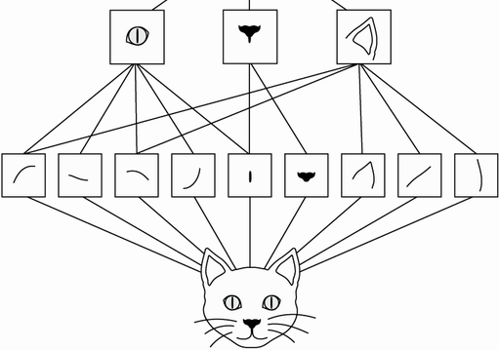
Extracting Image Features
Cat image is our Sample or Input
Example:
Max-Pooling Output
Convolutional Output
Max-Pooling Output
Convolutional Output
Process is repeated 3 times
Each new image is called a Feature Map
Notes:
https://www.geeksforgeeks.org/visualizing-representations-of-outputs-activations-of-each-cnn-layer/
The number of filter increases at each layer
The subsequent filters identify larger and larger patterns within the image
They can learn spatial hierarchies of patterns. A first convolution layer will learn small local patterns such as edges, a second convolution layer will learn larger patterns made of the features of the first layers, and so on (see figure 8.2). This allows convnets to efficiently learn increasingly complex and abstract visual concepts, because the visual world is fundamentally spatially hierarchical. (Chollet)

Slide 13
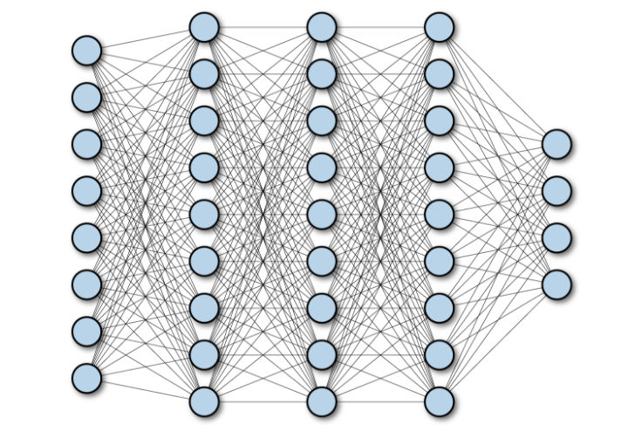

Flattening
Feature Maps Flattened Into One Array
Max-Pooling Output
Fully Connected Neural Network
Output
(Classification or Regression)
$$⋮$$

Slide 14
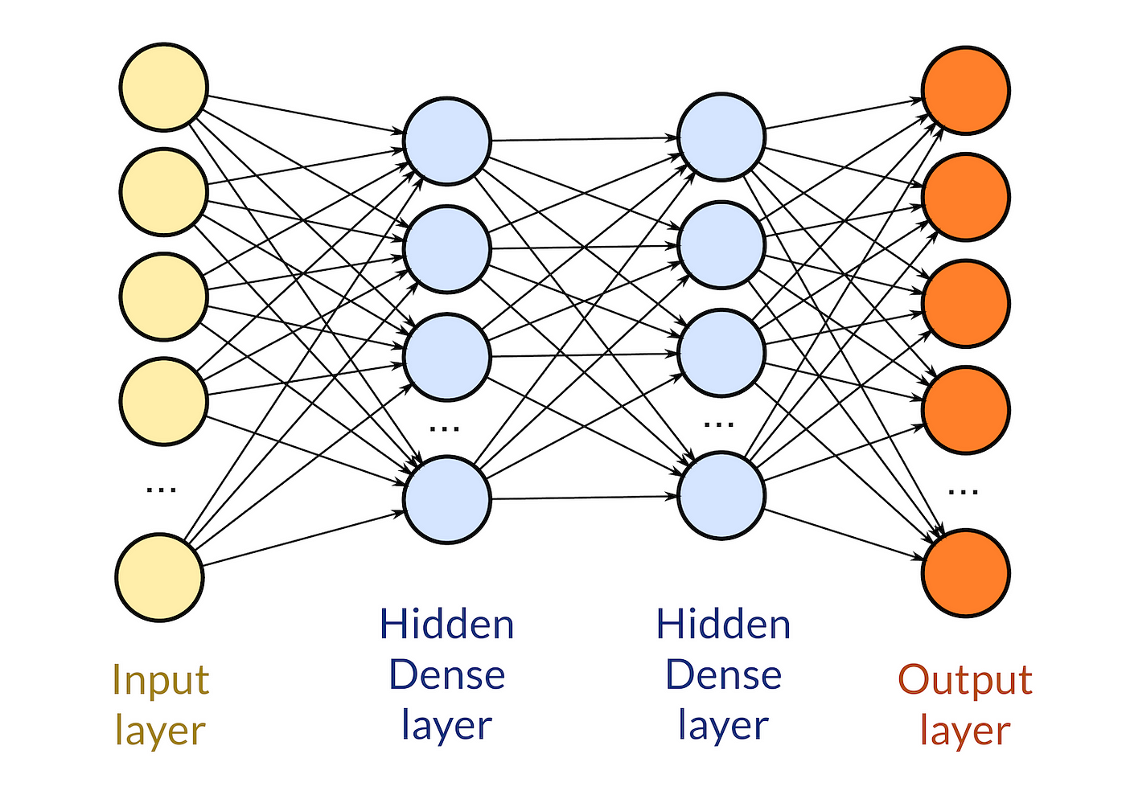
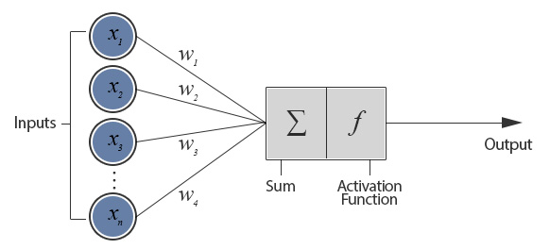
Fully Connected Neural Network
Perceptrons
Dense Layers
Input data is multiplied by learned weights, aggregated, then passed through an activation function
Layers of perceptrons which transfer information from layer to layer, to the output value(s)
https://sites.cc.gatech.edu/~san37/post/dlhc-fnn/
https://medium.datadriveninvestor.com/custom-layers-in-keras-de5f793217aa

Slide 15
Handwriting Classification Example
Convolutional Layer
Pooling Layer
Convolutional Layer
Pooling Layer
Flattening
Fully Connected Neural Network of Dense Layers
Input Image
Output for Classification

Slide 16
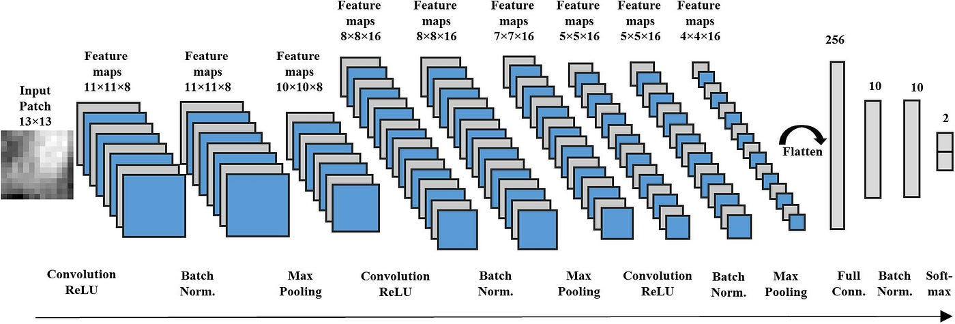
Batch Normalization
During training, predictor data is sent in small subsets, called a batch. But these batches are not always representative of the entire dataset
A batch normalization layer is added to normalize the feature maps between layers
Batch normalization has been found to help smoothen and quicken training
https://medium.com/analytics-vidhya/everything-you-need-to-know-about-convolutional-neural-networks-cnns-3a82f7aa29c5

Slide 17
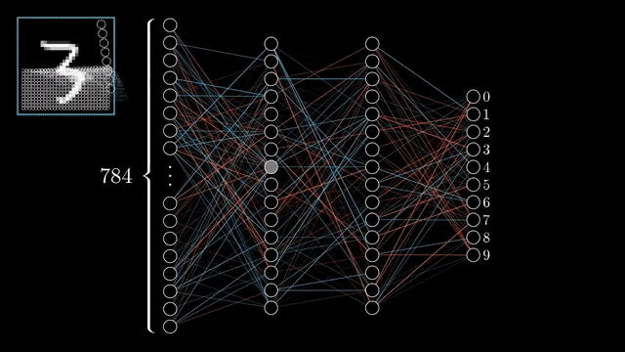
How does the Model Learn? Formulating Error
Prediction error or loss – The measurement of the distance between your model’s prediction and the target
Minimizing the loss function is how the algorithm “learns”
Common Loss Metrics:
Binary | Categorical | Numerical
Binary Cross Entropy | Categorical Cross Entropy | Mean Squared Error Mean Absolute Error

Slide 18
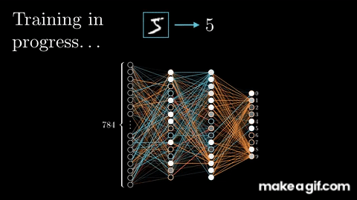
How does the Model Learn? Backpropagation
Backpropagation – updates the weights within the model to minimize the loss using the gradient

Slide 19
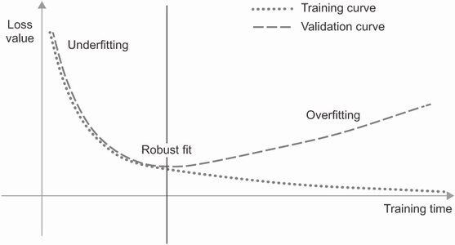
Overfitting to the Training Subset
Optimization – Adjusting the model for the best performance
Generalization – How well the trained model performs on data it has never seen
Overfitting – Learning representations only specific to the training data and do not generalize to the validation data

Slide 20
Overfitting to the Training Subset
Optimization – Adjusting the model for the best performance
Generalization – How well the trained model performs on data it has never seen
Overfitting – Learning representations only specific to the training data and do not generalize to the validation data
Challenges:
Noisy training data
Ambiguous features
Rare features
Spurious correlations (correlation is not causation)

Slide 21

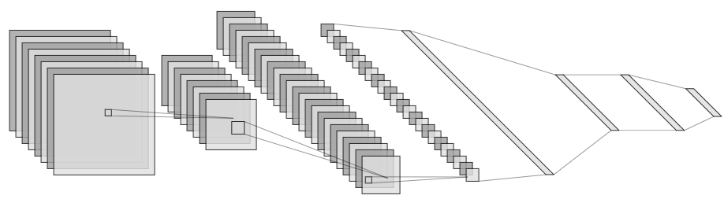
Grad-CAM (Gradient-weighted Class Activation Maps)
What is in this image?
An Explainable AI technique to create ‘visual explanations’ for the decisions within a CNN
Formulate heatmap from the weighted summation of gradients from an output node to all the feature maps of the last convolutional layer
In short, Grad-CAMs highlight the grid points where the CNN is ‘looking’ during prediction
Animal Detector CNN
Where in the image is the CNN looking to identify the Dog and Cat?
96% Dog
92% Cat

Slide 22
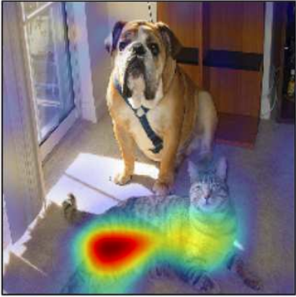
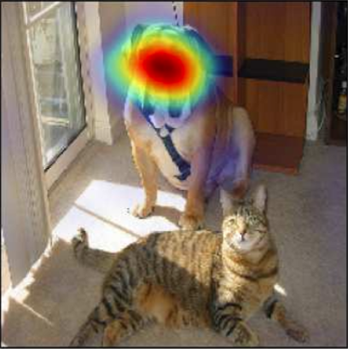
Grad-CAM (Gradient-weighted Class Activation Maps)
What is in this image?
Animal Detector CNN
Where in the image is the CNN looking to identify the Dog and Cat?
96% Dog
92% Cat
Grad-CAM:
Weighted summation of the gradients from an output node to all feature maps
Strong Gradients = High Importance
Grad-CAM for ‘Cat’
Grad-CAM for ‘Dog’

Slide 23
References
Black, A. W., and T. L. Mote, 2015: Characteristics of winter-precipitation-related transportation fatalities in the United States. Wea. Climate Soc., 7, 133–145.
Bohne, L., C. Strong, and W. J. Steenburgh, 2020: Climatology of orographic precipitation gradients in the contiguous western United States. J. Hydrometeor., 21, 1723–1740.
Burakowski, E., and M. Magnusson, 2012: Climate Impacts on Winter Tourism Economy in the United States. 36 pp.
Chase, R. J., D. R. Harrison, G. M. Lackmann, and A. McGovern, 2023: A Machine Learning Tutorial for Operational Meteorology. Part II: Neural Networks and Deep Learning. Wea. Forecasting, 38, 1271–1293, https://doi.org/10.1175/WAF-D-22-0187.1.
Chollet, F., and Coauthors, 2015: Keras. https://keras.io.
Chollet, F., 2021: Deep Learning with Python. Manning Publications Co., 478 pp.
Daly, C., R. P. Neilson, and D. L. Phillips, 1994: A statistical-topographic model for mapping climatological precipitation over mountainous terrain. J. Appl. Meteor. Climatol., 33, 140–158.
Gonzalez, R. C., 2020: Deep Convolutional Neural Networks [Lecture Notes]. IEEE Signal Processing Magazine, 35(6), 79-87, https://doi.org/10.1109/MSP.2018.2842646.
Haupt, S. E., and Coauthors, 2022: The History and Practice of AI in the Environmental Sciences. Bull. Amer. Meteor. Soc., 103, E1351–E1370, https://doi.org/10.1175/BAMS-D-20-0234.1.
Hersbach, H., and Coauthors, 2023a: ERA5 hourly data on pressure levels from 1940 to present. Copernicus Climate Change Service (C3S) Climate Data Store (CDS), accessed 18 January 2023, doi: 10.24381/cds.bd0915c6.476
Hersbach, H., and Coauthors, 2023b: ERA5 hourly data on single levels from 1940 to present. Copernicus Climate Change Service (C3S) Climate Data Store (CDS), accessed 28 January 2023, doi: 10.24381/cds.adbb2d47.
Ioffe, S., and C. Szegedy, 2015: Batch normalization: Accelerating deep network training by reducing internal covariate shift. Proc. 32nd Int. Conf. on Machine Learning, https://doi.org/10.48550/arXiv.1502.03167.
Lewis, W. R., W. J. Steenburgh, T. I. Alcott, and J. J. Rutz, 2017: GEFS precipitation forecasts and the implications of statistical downscaling over the western United States. Wea. Forecasting, 32, 1007–1028.
Li, D., M. L. Wrzesien, M. Durand, J. Adam, and D. P. Lettenmaier, 2017: How much runoff originates as snow in the western United States, and how will that change in the future? Geophysical Research Letters, 44, 6163–6172.
Selvaraju, R. R., M. Cogswell, A. Das, R. Vedantam, D. Parikh, and D. Batra, 2020: Grad-cam: Visual explanations from deep networks via gradient-based localization. Int. J. of Comput. Vis., 128, 336-359, https://doi.org/10.1007/s11263-019-01228-7.
Westerling, A. L., 2016: Increasing western US forest wildfire activity: Sensitivity to changes in the timing of spring. Phil. Trans. R. Soc. B, 371, http://doi.org/10.1098/rstb.2015.0178.

